Slide 1
An Overview of Cryptography (Part II)

Slide 2
Message Authentication
Protection against falsification of data and transactions
Message authentication is a procedure that allows communicating parties to verify that the received messages are authentic
Source is authentic
Contents of the message have not been altered
Sequence relative to other messages flowing between two parties
Message’s timeliness
Avoid replay attack

Slide 3
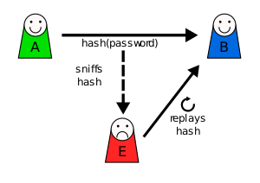
Replay attack
A user sends a hashed password to the server for authentication
The attacker sniffs the hashed password
Some time later, the attacker pretends to be the user and send the sniffed hashed password to the server
The following introduces different ways for message authentication
Image source: https://en.wikipedia.org/wiki/Replay_attack#/media/File:Replay_attack_on_hash.svg

Slide 4
Encrypt the Whole Message
Assume that only the sender and the receiver share the secret key for conventional encryption (e.g., AES)
Only the true sender would be able to encrypt a message successfully
Include an error-detection code
Ensure that no alternations have been made
Include a sequence number
Ensure that the sequencing is proper
Include a timestamp
Ensure that the message has not been delayed to avoid the replay attack
Drawback
Time consuming to encrypt and decrypt all messages

Slide 5
Authentication Tag
Generated and appended to each message
The message itself is not encrypted and can be read at the destination independent of the authenticating function
Advantage: Save execution time for decryption
E.g., one side has a heavy load and cannot afford the time to decrypt all incoming messages
E.g., a sender sends a broadcast message to many receivers
Disadvantage: Message confidentiality is not provided
May not be a problem for broadcast messages
Here introduces two kinds of authentication tag
Message Authentication Code (MAC)
Using one-way hash function

Slide 6
Message Authentication Code (MAC)
A small block of data generated by the secret key
Both parties (A and B) share a common secret key K_{AB}
When A sends a message M to B
A calculates the message authentication code MAC_{M}
MAC_{M} = F(K_{AB}, M)
A sends M and MAC_{M} to B
B performs the same calculation to obtain MAC_{M}
The calculated code is compared with the received code
If they are the same, the message is authentic
However, it may not be efficient if the size of M is very large

Slide 7
Message Authentication using a Message Authentication Code (MAC)
Message
K_{AB}
Transmit
MAC
Algorithm
Compare
MAC
Algorithm
MAC
K_{AB}

Slide 8
One-way Hash Function H
Accept a variable-size message M as input
Produce a fixed-size message digest h as output
One-way hash function H(M) = h:
Given M, it is computationally easy to generate h
Given h, it is computationally infeasible to find M
Example
The SHA256 hash of “a” (without quote) is
CA978112CA1BBDCAFAC231B39A23DC4DA786EFF8147C4E72B9807785AFEE48BB
The SHA256 hash of “a…a” (1000 a’s) is
41EDECE42D63E8D9BF515A9BA6932E1C20CBC9F5A5D134645ADB5DB1B9737EA3
Notes:
https://passwordsgenerator.net/sha256-hash-generator/

Slide 9
In our daily life, when we download a file from the Internet, sometimes it is accompanied by a hash value
It is used as the checksum to ensure the integrity of the downloaded file
Every bit of the downloaded file is the same as that of the file on the server side
Back to our case, unlike the MAC function, the one-way hash function H does not take a secret key as input.
To authenticate a message, the message digest h is computed and sent together with the message in such a way that h is authentic, such as
Using Conventional Encryption
Using Public-key Encryption
Using Secret Value

Slide 10
(a) Using Conventional Encryption
Message
Transmit
H
K_{AB}
Compare
D
H
K_{AB}
Authentication: Yes
Nonrepudiation: No
E
The sender can deny that he/she sent the message.
It is because the receiver also knows K_{AB}.
It is possible that the receiver pretends to be the sender to send the message to himself/herself.
Notes:
Nonrepudiation: After the sender sending a message, the sender cannot deny that

Slide 11
(b) Using Public-key Encryption
Message
Transmit
H
K_{public}
Compare
D
H
K_{private}
Authentication: Yes
Nonrepudiation: Yes
E
Encryption: sender's private key
Decryption: sender's public key
The receiver does not have the sender's private key → ensure nonrepudiation

Slide 12
(c) Using Secret Value (Shared by the Sender and the Receiver)
Secret
value
Secret
value
Message
Transmit
H
Compare
H
Authentication: Yes
Nonrepudiation: No
The advantage is that no encryption or decryption are required.

Slide 13
Secure Hash Functions
One-way hash function
Produce a “fingerprint” for a file, a message, or a block of data.
Important for
Password hashing
File integrity checking
Message authentication
Digital signatures

Slide 14
Requirements (for hash function H)
The following three requirements are for the convenience and efficiency of practical applications.
H can be applied to a block of data of any size.
H produces a fixed-length output.
H(x) is relatively easy to compute for any given x, making both hardware and software implementations practical.
The next three requirements are for security issues.

Slide 15
Suppose H(x) = h. For any given digest h, it is computationally infeasible to find x.
Preimage Resistance
The one-way property
If this requirement is not satisfied
Our passwords in plaintext can be deduced from the hashed passwords stored in /etc/shadow in Linux
For method (c), the attacker can deduce the secret value and can pretend to be the sender to send any message

Slide 16
Suppose H(x) = H(y), where x ≠ y. For any given block x, it is computationally infeasible to find y.
Second Preimage Resistance
Also called Weak Collision Resistance
A collision occurs when H(x) = H(y), where x ≠ y
A collision must exist for hash functions
The number of possible combinations of input far exceeds the number of possible combinations of output
There must exist some inputs having the same output (the Pigeonhole principle)
This requirement requires that even though collisions must exist, they are difficult to be found
If this requirement is not satisfied, in methods (a) / (b)
M is exposed
Easy for the attacker to find another message M’, where H(M) = H(M’)
It follows that Encrypted H(M) = Encrypted H(M’)
Since Encrypted H(M) is also exposed, the attacker does not need to know the secret key / the private key to obtain the encrypted digest for M’
The attacker can append Encrypted H(M) to M’, and pretend the sender to send M’.

Slide 17
It is computationally infeasible to find any pair of (x, y) such that H(x) = H(y).
Strong Collision Resistance
A hash function having this property is a strong hash function.
Otherwise, it is a weak hash function.
This property is used to protect against the birthday attack

Slide 18
Birthday Paradox
It gets its name from the surprising result that the probability that two or more people in a group of 23 share the same birthday is greater than 0.5.
If a function, when supplied with a random input, returns one of k equally-likely values, then by repeatedly evaluating the function for different inputs, the chance to have the same output is 50% after about 1.2k^{0.5} samples.
For the above birthday paradox, replace k with 365.
For simplicity, we exclude leap year and assume that the 365 possible birthdays are equally-likely.
The chance of two or more people having the same birthday:
100% for 366 people
99.9% for 70 people
50.7% for 23 people

Slide 19
Birthday Attack
To sign a message, the sender has to append a m-bit signature
The signature can be obtained by applying a hash function to the message and then encrypt the digest using the private key
But if the hash function does not satisfy the 6th property, an attacker can trick a victim to sign a fraudulent message by the steps on the next page

Slide 20
Generate a set of 2^{m/2} normal messages, all conveying the same meaning.
Generate another set of 2^{m/2} fraudulent messages, all conveying another meaning in the same way.
Match the two sets to find a pair of messages (one normal and one fraudulent) with the same digest.
By birthday paradox, the probability of success is high.
Offer the victim the paired normal message to sign to obtain the signature (encrypted digest of the paired normal message)
Encrypted digest of the paired normal message = Encrypted digest of the paired fraudulent message
Attach the signature with the paired fraudulent message and claims that the victim has signed the paired fraudulent message
Normal Messages
Fraudulent Messages
Yes
Yes!
Yes!!
YES
Sure
No problem
…
No
No!
No!!
NO No way
Negative
…

Slide 21
MD5 (Message Digest Algorithm 5)
Developed by Ron Rivest in 1992.
Input: arbitrary length.
Output: 128-bit message digest.
On paper, finding a message with a given digest is on the order of 2¹²⁸ operations.
On paper, finding a collision (two messages having the same message digest) is on the order of 2⁶⁴ operations.
The following diagrams highlight the MD5 algorithm

Slide 22
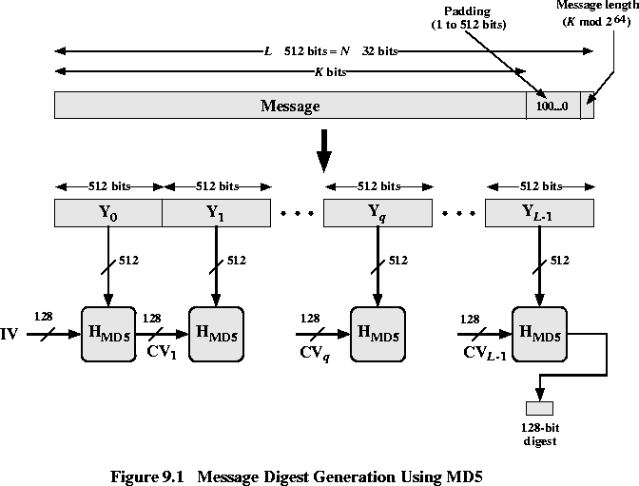
Source:http://cwx.prenhall.com/bookbind/pubbooks/stallings8/chapter0/deluxe.html

Slide 23
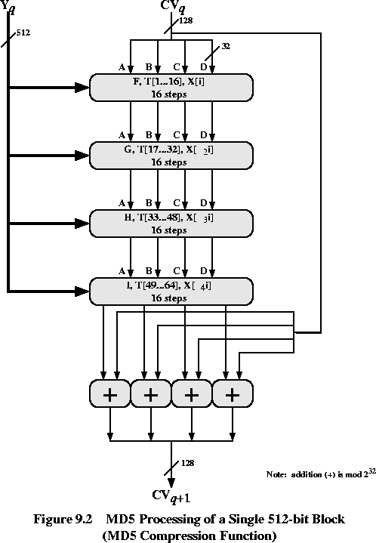
Source:http://cwx.prenhall.com/bookbind/pubbooks/stallings8/chapter0/deluxe.html

Slide 24
However, MD5 is now considered broken in terms of collision resistance
A practical collision attack with the complexity of 2¹⁸ operations was presented in 2013
Can be done by modern computers in terms of seconds
Hence, MD5 should not be used for the applications that rely on the collision resistance, such as digital signatures and digital certificates
Notes:
MD5 Collision
http://www.mscs.dal.ca/~selinger/md5collision/
References:
- Xie Tao, Fanbao Liu, and Dengguo Feng, Fast Collision Attack on MD5, EUROCRYPT 2013
Yu Sasaki and Kazumaro Aoki, Finding Preimages in Full MD5 Faster than Exhaustive Search, EUROCRYPT 2009
- Nvidia RTX 2080 Ti Hashcat Benchmarks
https://gist.github.com/binary1985/c8153c8ec44595fdabbf03157562763e
- Nvidia Titan RTX Hashcat Benchmarks
https://gist.github.com/Chick3nman/5d261c5798cf4f3867fe7035ef6dd49f
- 8x Nvidia GTX 1080 Ti Hashcat Benchmarks
https://gist.github.com/epixoip/ace60d09981be09544fdd35005051505

Slide 25
The preimage resistance of MD5 still holds
There is only a theoretical preimage attack with the complexity of 2^{123.4} operations, presented in 2009
Nvidia GeForce RTX 2080 Ti GPU: 50515.3MH/s ≈ 2^{35.55}H/s
Nvidia Titan RTX GPU: 64019.6MH/s ≈ 2^{35.90}H/s
8x Nvidia GeForce GTX 1080 Ti GPUs: 307.2GH/s ≈ 2^{38.16}H/s
Estimate: 2^{123.4} / 2^{38.16} seconds ≈ 10¹⁸ years
But some still suggest that MD5 is not considered as a good password hashing function nowadays
The computation of MD5 is “too fast”
In practice, dictionary attack can be achieved in a shorter time if only weak passwords are used
Notes:
MD5 Collision
http://www.mscs.dal.ca/~selinger/md5collision/
References:
- Xie Tao, Fanbao Liu, and Dengguo Feng, Fast Collision Attack on MD5, EUROCRYPT 2013
Yu Sasaki and Kazumaro Aoki, Finding Preimages in Full MD5 Faster than Exhaustive Search, EUROCRYPT 2009
- Nvidia RTX 2080 Ti Hashcat Benchmarks
https://gist.github.com/binary1985/c8153c8ec44595fdabbf03157562763e
- Nvidia Titan RTX Hashcat Benchmarks
https://gist.github.com/Chick3nman/5d261c5798cf4f3867fe7035ef6dd49f
- 8x Nvidia GTX 1080 Ti Hashcat Benchmarks
https://gist.github.com/epixoip/ace60d09981be09544fdd35005051505

Slide 26
Other Secure Hash Functions
As was the case with symmetric block ciphers, designers of secure hash functions have been reluctant to depart from a proven structure.
DES : Feistel cipher
Many subsequent block ciphers follow the Feistel design.
Similarly, most important modern hash functions follow the basic structure of Merkle–Damgård (MD) construction.
See next page
The structure can produce a secure hash function.
Concentrate to design a collision-resistant compression function.

Slide 27
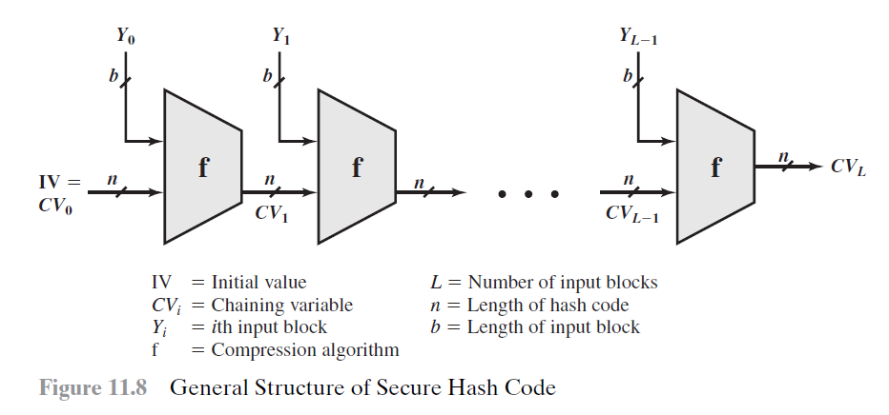
Notes:
Reference: Stallings, Cryptography and Network Security: Principles and Practice

Slide 28
SHA-1 (Secure Hash Algorithm 1)
Developed by the National Institute of Standard and Technology (NIST).
Published as a Federal Information Processing Standard (FIPS PUB 180) in 1993.
The revised version was issued in 1995 and is generally referred to as SHA-1.
Structure: Merkle–Damgård (MD) construction
Input message with max length of 2⁶⁴ – 1 bits.
Output a 160-bit message digest.
The following diagram shows the compression function used by SHA-1

Slide 29
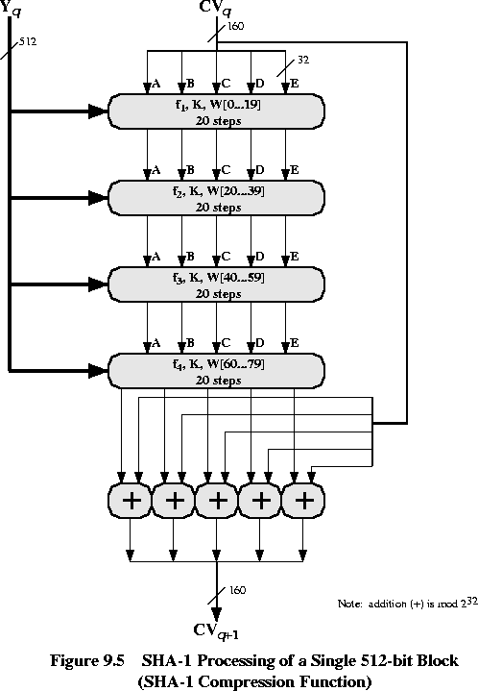
Source:http://cwx.prenhall.com/bookbind/pubbooks/stallings8/chapter0/deluxe.html

Slide 30
However, SHA-1 is deprecated in 2011 by NIST due to fundamental security weaknesses demonstrated in various analyses and theoretical attacks
The first practical freestart collision attack with complexity of 2^{57.5} on SHA-1 was presented in 2015
Freestart collision: the attacker can choose the IV
A collision can be found in about 10 days on 64x Nvidia GeForce GTX 970 GPUs
The first practical concrete collision attack with complexity 2⁶³ on SHA-1 was presented in 2017
It took 1 year for 110x GPUs
Notes:
References:
- M. Stevens, P. Karpman, and T. Peyrin, Freestart collision for full SHA-1, EUROCRYPT 2016
- Stevens, Marc; Bursztein, Elie; Karpman, Pierre; Albertini, Ange; Markov, Yarik. "The first collision for full SHA-1". Shattered IO. Retrieved 23 February 2017.

Slide 31
SHA-2 (Secure Hash Algorithm 2)
A family of 6 hash functions developed by National Security Agency (NSA) in US first published in 2001
SHA-224
Digest size: 224 bit
SHA-256
Digest size: 256 bit
Popular, faster than SHA-512 on 32-bit machines
SHA-384
Digest size: 384 bit
SHA-512
Digest size: 512 bit
Popular, faster than SHA-256 on 64-bit machines
SHA-512/224
Truncate SHA-512 to digest size with 224 bit
SHA-512/256
Truncate SHA-512 to digest size with 256 bit
Notes:
S. Gueron, S. Johnson, and J. Walker. SHA-512/256. http://eprint.iacr.org/2010/548.pdf.

Slide 32
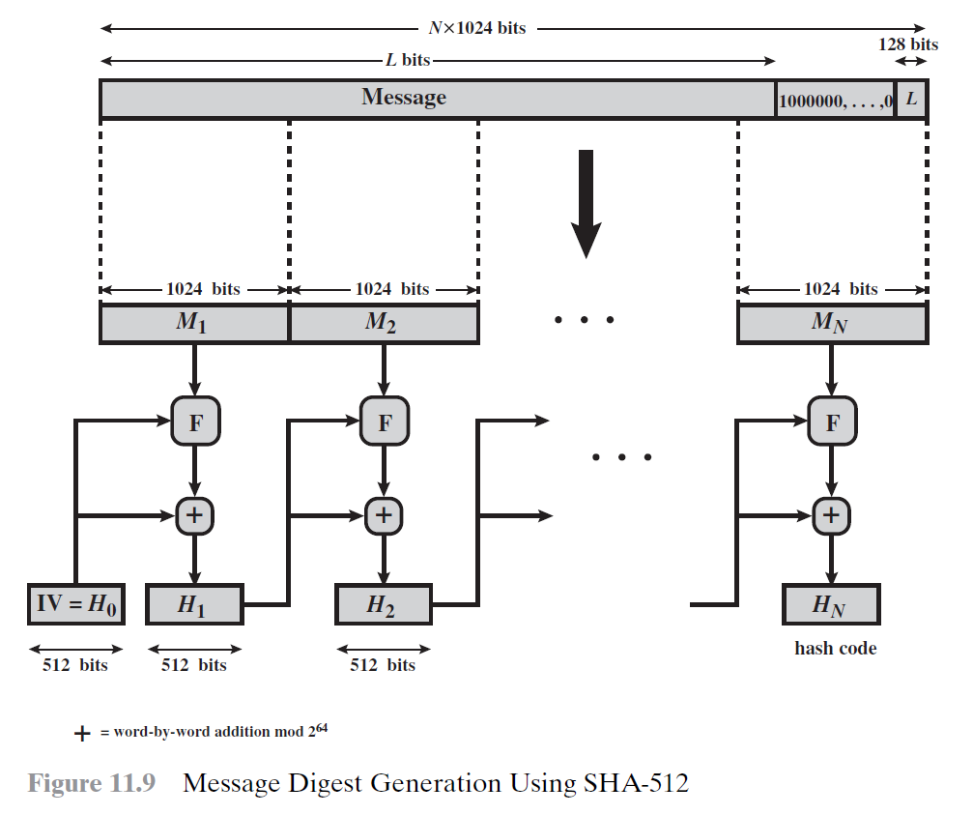
Image source: Stallings, Cryptography and Network Security: Principles and Practice (6th Edition)
Notes:
Reference: Stallings, Cryptography and Network Security: Principles and Practice

Slide 33
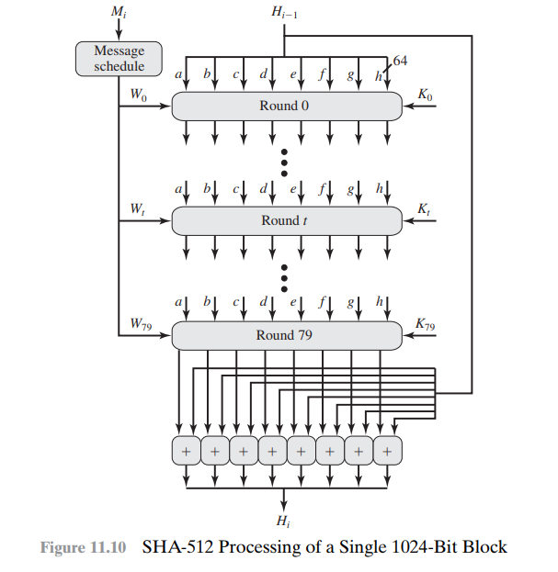
Image source: Stallings, Cryptography and Network Security: Principles and Practice (6th Edition)
Notes:
Reference: Stallings, Cryptography and Network Security: Principles and Practice

Slide 34
 | MD5 | SHA-1 | RIPEMD-160 | SHA-2 | SHA-3
Digest Length (in bits) | 128 | 160 | 160 | 224 / 256 / 384 / 512 | 224 / 256 / 384 / 512 / arbitrary
Block Size (in bits) | 512 | 512 | 512 | 512 / 1024 | 1152 / 1088 / 832 / 576 / 1344 / 1088
Number of Rounds | 64 (4 round of 16) | 80 (4 rounds of 20) | 160 (5 paired rounds of 16) | 64 / 80 | 24
Maximum Message Size | ∞ | 2⁶⁴-1 | ∞ | 2⁶⁴-1 / 2¹²⁸-1 | ∞
Remark | Collisions found | Collisions found | Used in PGP and Bitcoin (allowing shorter Bitcoin address) | Widely used | A new hashing standard in 2015
Notes:
Cryptography and Network Security (3rd Edition), A.Kahate, McGraw Hill

